Slide 1


Elvis Khosa
NET Developer
Online Store Presentation
Server : https://github.com/KhosaElvis/EKStoreApi
Client : https://github.com/KhosaElvis/eStore
Database: EF Code First Approach, The Serve generates new database when it run on the SQLEXPRESS server

Slide 2
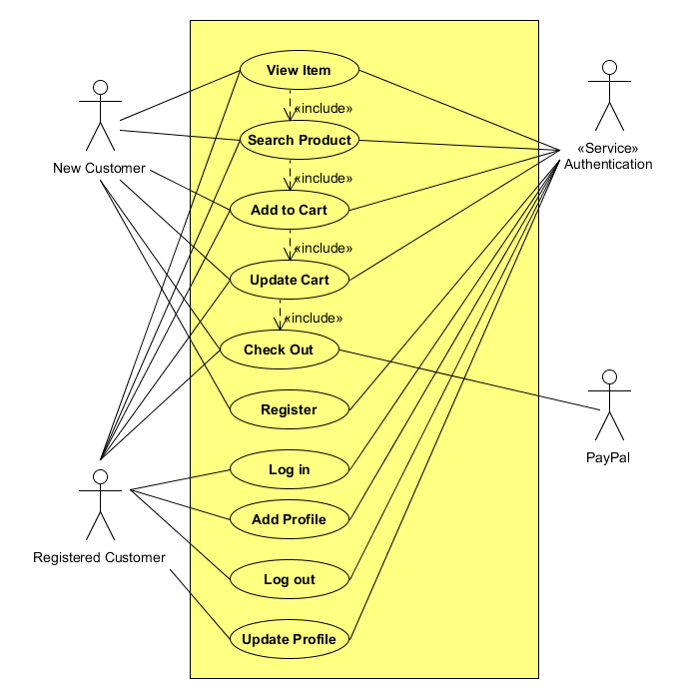
Use Case -> Customers

Slide 3
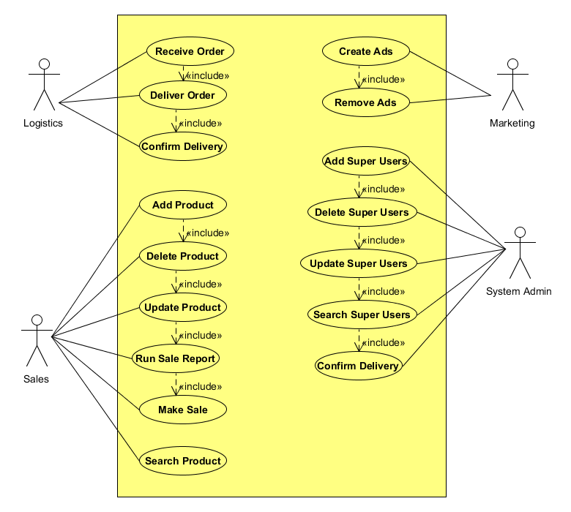
Use Case -> Employees

Slide 4
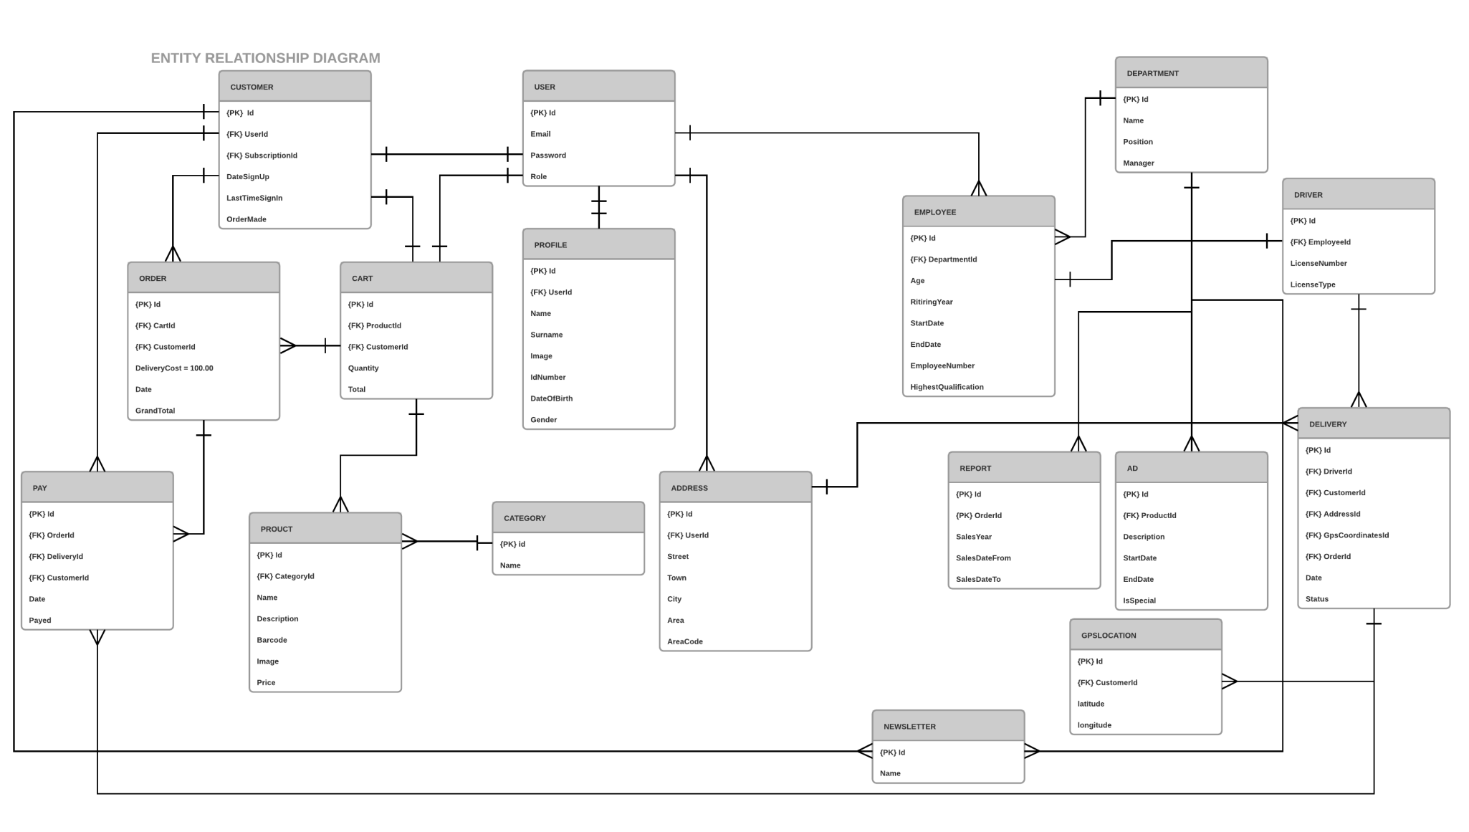
ERD

Slide 5
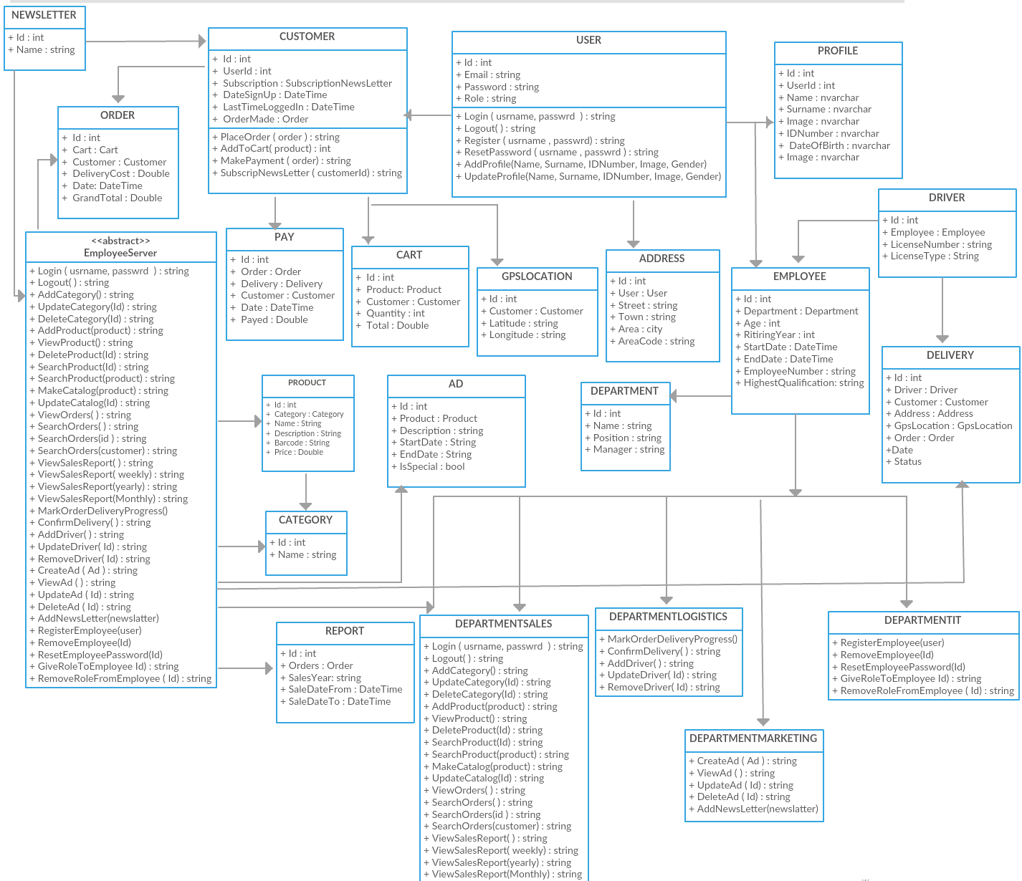
Class Diagram

Slide 6
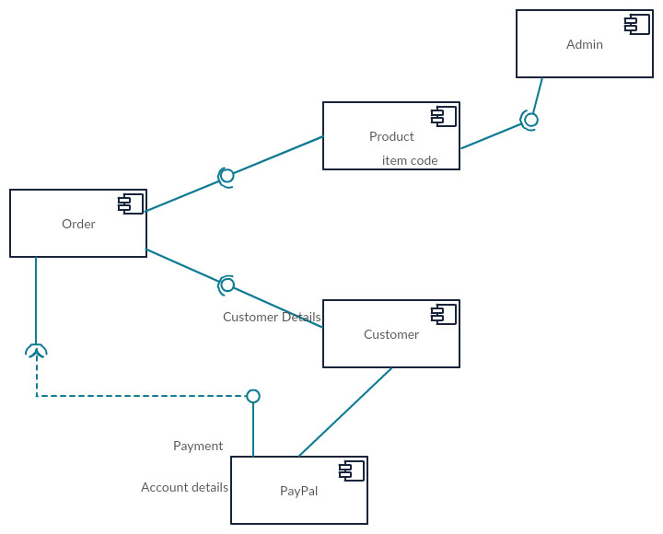
Component Diagram

Slide 7
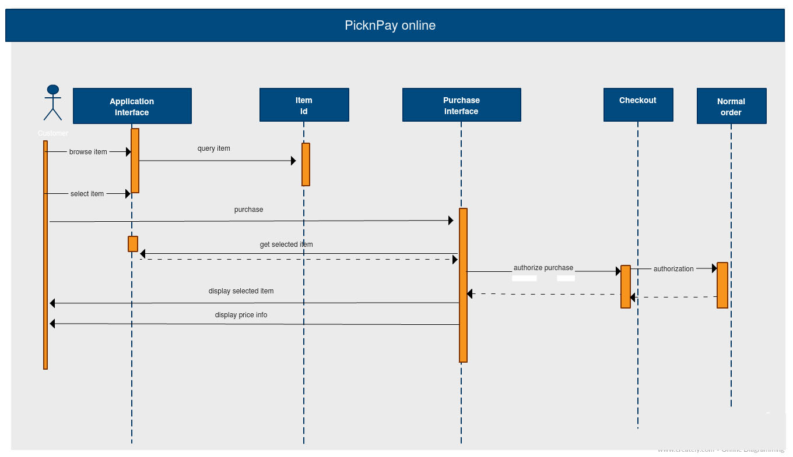
Sequence Diagram

Slide 8
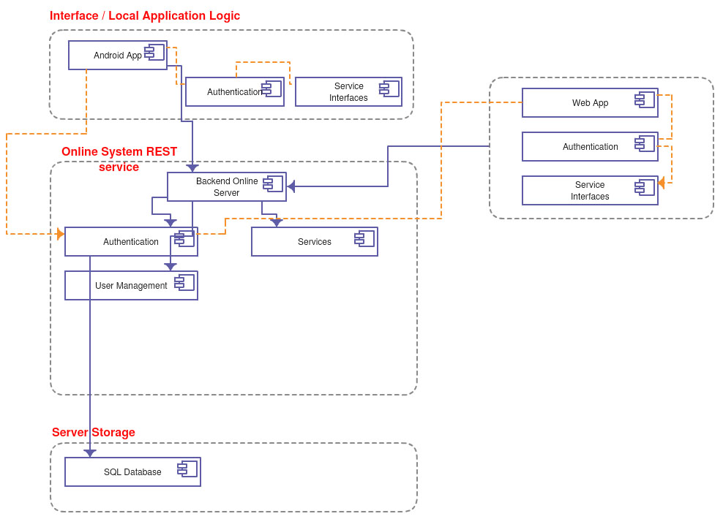
Architecture Diagram
XAML, C#
Presentation Layer
C#, HTML, Angular, Bootstrap , CSS, Jquery
C#, Linq , XML
Business Layer
TSQL , EF
Data Layer

Slide 9
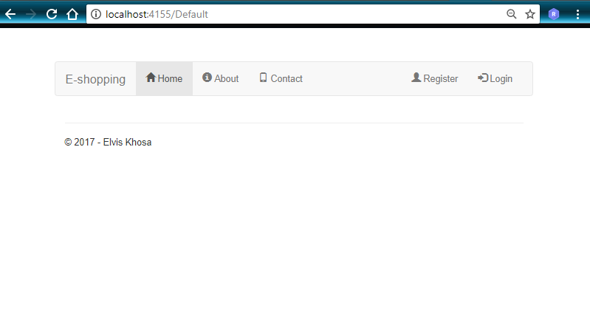
Default / Home Page on a Medium Screen Size

Slide 10
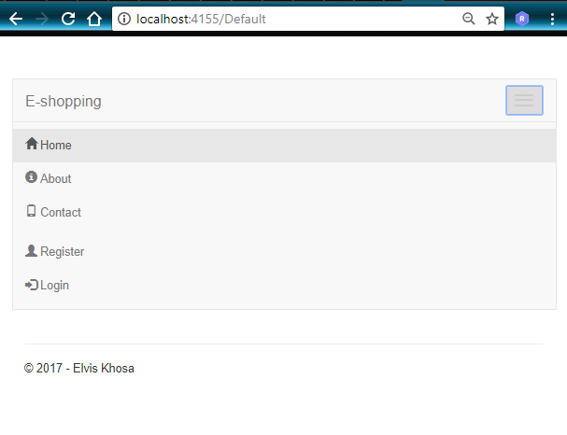
Default / Home Page on a Small Screen Size

Slide 11
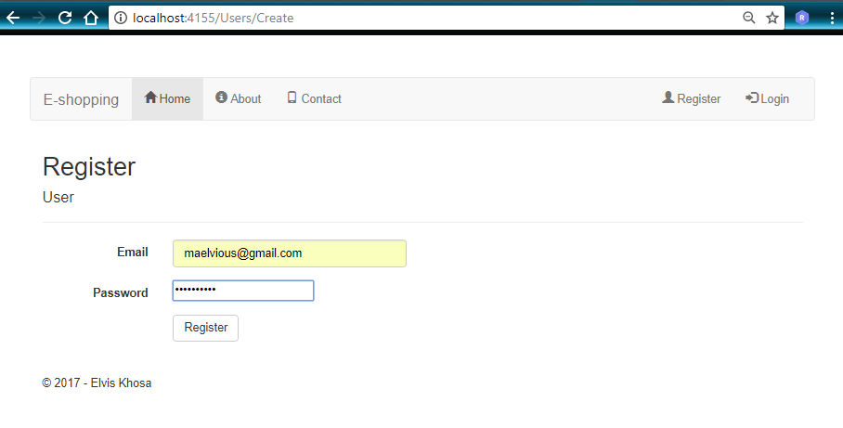
Register – Customer User

Slide 12
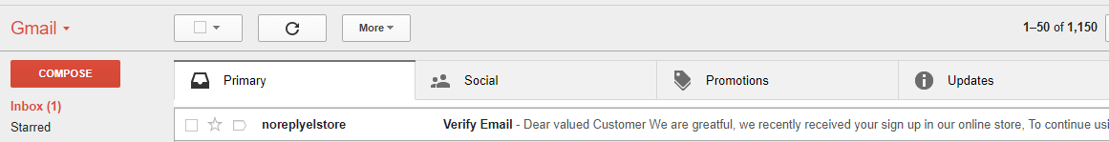
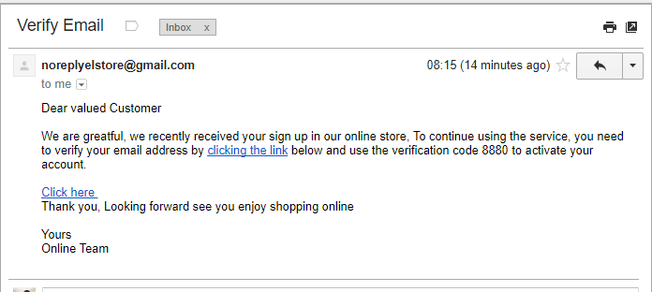
Email – To Verify , Customer Exist
At this stage the page to verify is not yet designed, but will use the random number in the email to verify if the user.

Slide 13
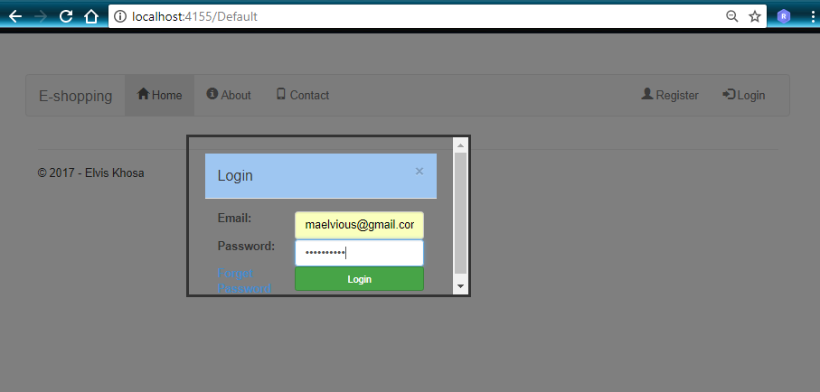
Login Modal

Slide 14
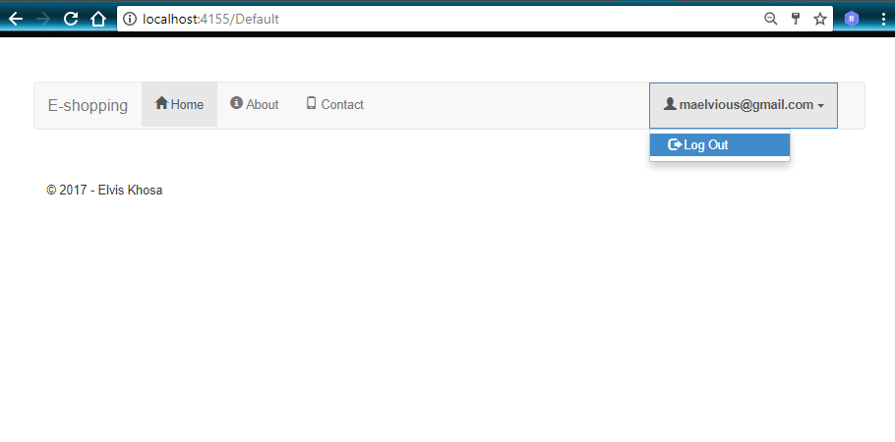
User Logged - In

Slide 15
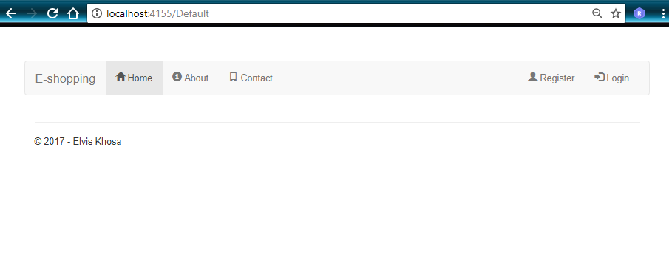
Logged-Out

